Slide 1
Chapter 1: LANs, WANs, and the Internet
Notes:
Cisco Networking Academy program
Introduction to Networks
Chapter 1: Exploring the Network

Slide 2
Components of a Network
There are three categories of network components:
Devices (End Devices, Network Infrastructure devices)
Media (Cable or wireless)
Services (Software run on networked devices)
End device – familiar network devices
- Interfaces between users and the network
Notes:
Section 1.2.1.1

Slide 3
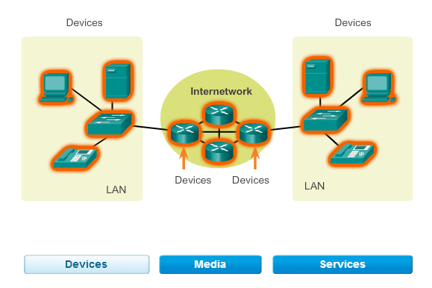
The network devices that people are most familiar with are called
end devices, or hosts. These devices form the interface between
users and the underlying communication network.
End device – familiar network devices
- Interfaces between users and the network
Notes:
Section 1.2.1.1

Slide 4
Components of Network: End Devices
End devices form interface with human network & communications network
End devices are referred to as hosts.
A host device is either the sender or receiver
To uniquely identify one host from another, each host on a network is identified by an address.
Destination host address specifies where the message should be sent.
Software determines the role of a host. A host can be a client, server or both
Examples of end devices are:
Computers (work stations, laptops, file servers, web servers)
Network printers
VoIP phones
Security cameras
Mobile handheld devices (such as wireless barcode scanners, PDAs)

Slide 5
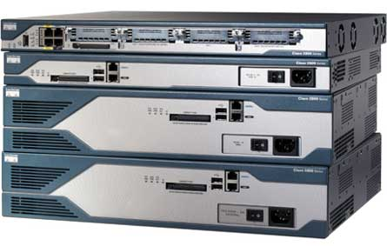
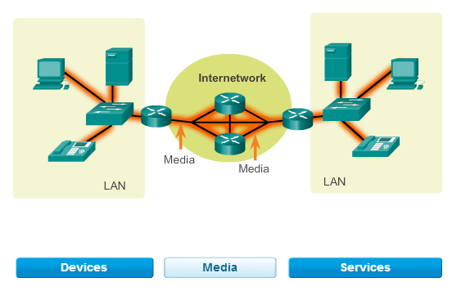
Intermediary Devices
Devices along the way which carries the data to the destination
Use alternate pathways when there is a link failure.
Filter the flow of data based on security settings.
Examples of intermediary network devices are:
Network Access Devices (switches, and wireless access points)
Internetworking Devices (routers)
Security Devices (firewalls)
Notes:
Section 1.2.1.3

Slide 6
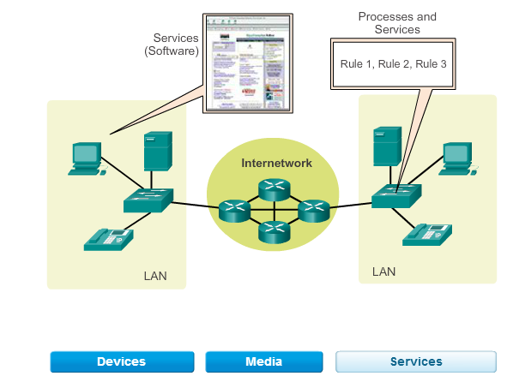
A network service provides information in response to a request.
Services include many of the common network applications
people use every day, like email hosting services and web hosting
services.
Notes:
Section 1.2.1.1

Slide 7
Services
Network components are used to provide services and processes.
These are the communication programs, called software, that run on the networked devices.
A network service provides information in response to a request.
Services include many of the common network applications people use every day, like email hosting services and web hosting services.
Processes provide the functionality that directs and moves the messages through the network.
Processes are less obvious to us but are critical to the operation of networks.
Notes:
I honestly cannot understand this slide if I am the student. What is the actual difference of communication programs, services, processes are very blurr

Slide 8
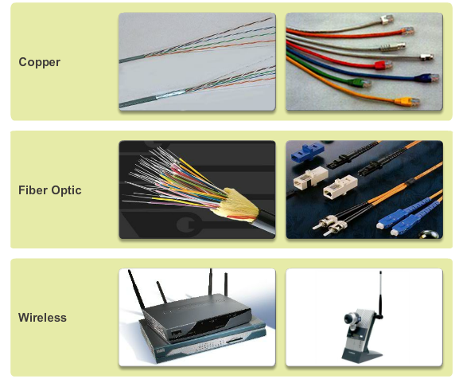
Network Media
Modern networks primarily use three types of media to interconnect devices and to provide the pathway over which data can be transmitted.
Metallic wires
within cables
Glass or plastic fibers
(fiber optic cable)
Wireless transmission
Notes:
Section 1.2.1.4

Slide 9
Network Media
The signal encoding that must occur for the message to be transmitted is different for each media type
Criteria for choosing a network media are:
- The distance the media can successfully carry a signal.
- The environment in which the media is to be installed.
- The amount of data and the speed at which it must be
transmitted.
- The cost of the media and installation
Media | Example | Encoding
Copper | Twisted pair cable used as LAN media | electrical impulses
Fiber-Optic | Glass or plastic fibers in a vinyl coating for long runs in a LAN and as a trunk | Light pulses
Wireless | Connects local users through the air | Electromagnetic waves

Slide 10
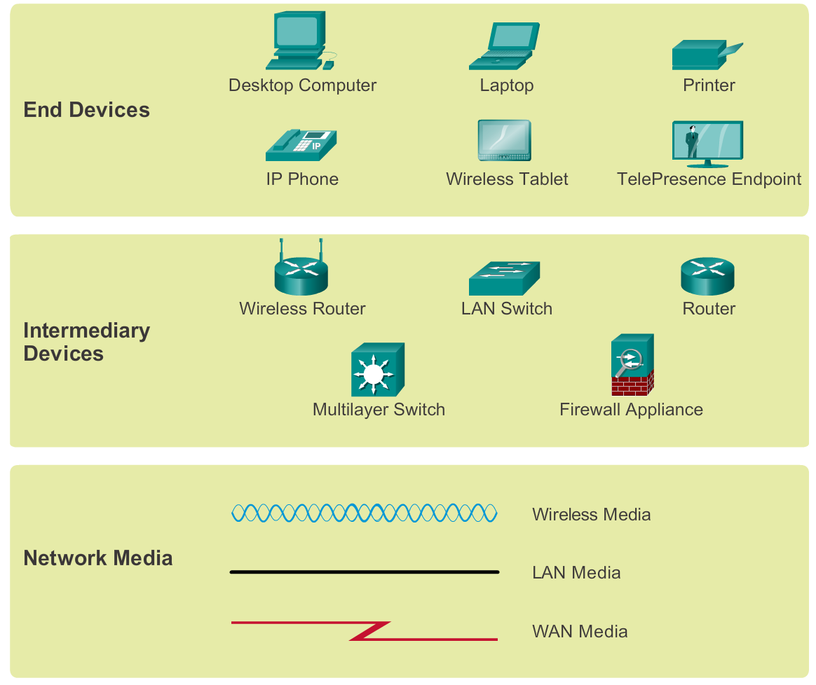
Network Representations
Notes:
Section 1.2.1.5

Slide 11
Network Representations
How each of these devices and media connect to each other.
Network Interface Card - A NIC, or LAN adapter, provides the physical connection to the network at the PC or other host device. The media plug into the NIC to connect the PC to the network
Physical Port - A connector or outlet on a networking device where the media is connected to a host or other networking device.
Interface - Specialized ports on an internetworking device that connect to individual networks. Because routers are used to interconnect networks, the ports on a router are referred to network interfaces.
Notes:
What is the actual difference between physical port and interface? Maybe can show through diagrams

Slide 12
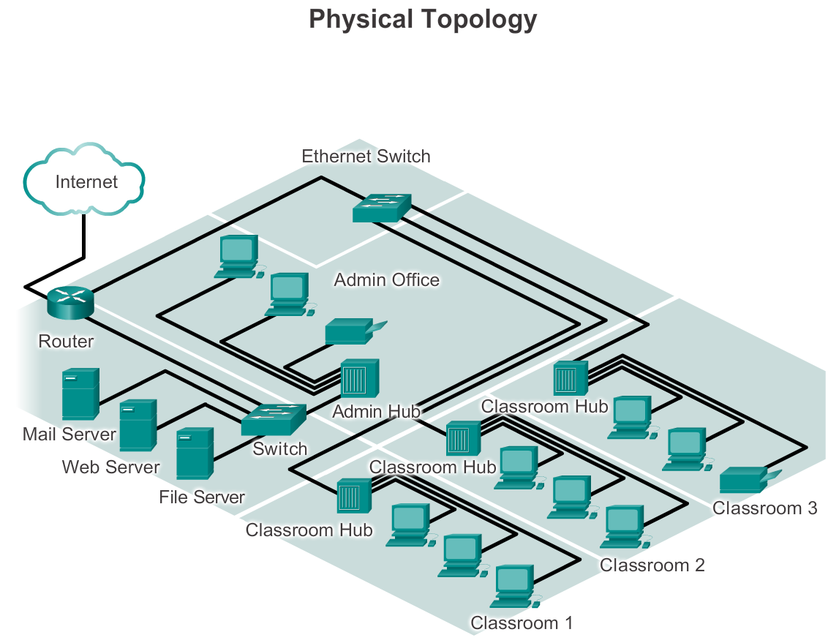
Topology Diagrams
Physical topology diagrams - Identify the physical location of intermediary devices, configured ports, and cable installation.
Notes:
Section 1.2.1.6

Slide 13
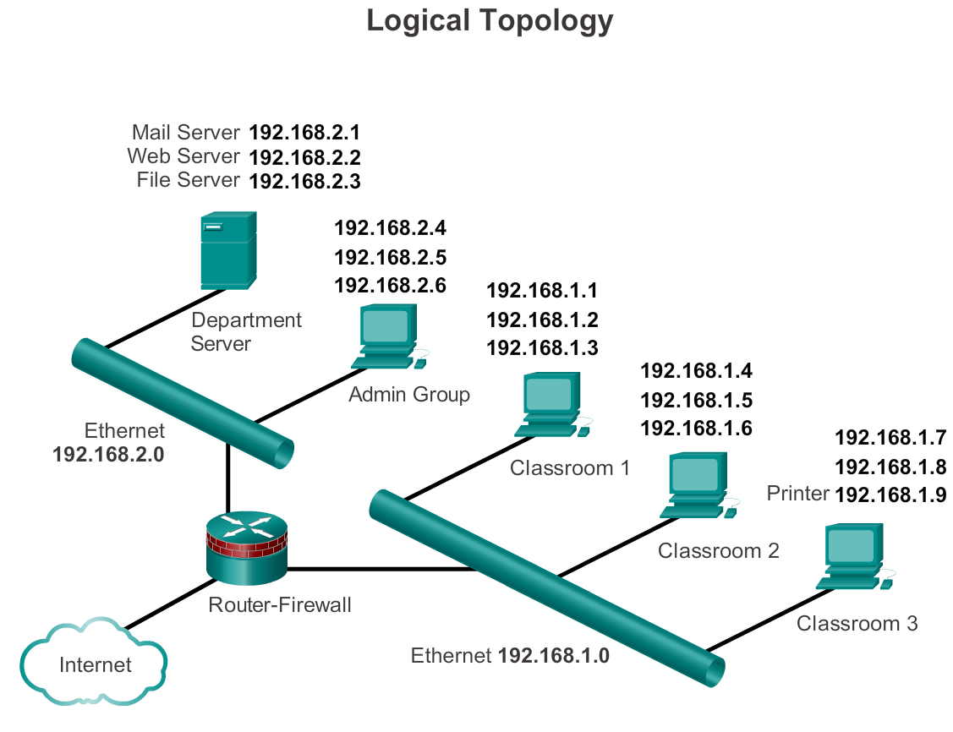
Topology Diagrams
Logical topology diagrams - Identify devices, ports, and IP addressing scheme.
Notes:
Section 1.2.1.6

Slide 14
Types of Networks
The two most common types of network infrastructures are:
Local Area Network (LAN)
Wide Area Network (WAN).
Other types of networks include:
Metropolitan Area Network (MAN)
Wireless LAN (WLAN)
Storage Area Network (SAN)
Networks are categorised according to size
Notes:
Section 1.2.2.1
There exists another network called PAN Personal area network - bluetooth

Slide 15
Local Area Networks (LAN)
Covers a small geographical area.
Notes:
Section 1.2.2.2

Slide 16
Local Area Networks (LAN)
Specific features of LANs include:
LANs interconnect end devices in a limited area such as a home, school, office building, or campus.
A local area network (LAN) is a computer network that interconnects computers within a limited area such as a residence, school, laboratory, university campus or office building.
LANs provide high speed bandwidth to internal end devices and intermediary devices.

Slide 17
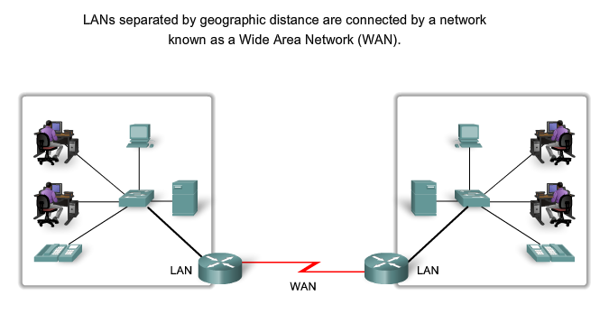
Wide Area Networks (WAN)
A network infrastructure that provides access to other networks over a wide geographical area.
Notes:
Section 1.2.2.3

Slide 18
Wide Area Networks (WAN)
Wide Area Networks (WANs) are a network infrastructure that spans a wide geographical area. WANs are typically managed by service providers (SP) or Internet Service Providers (ISP).
Specific features of WANs include:
WANs interconnect LANs over wide geographical areas such as between cities, states, provinces, countries, or continents.
WANs are usually administered by multiple service providers.
WANs typically provide slower speed links between LANs.

Slide 19
Metropolitan Area Network (MAN) - A network infrastructure that spans a physical area larger than a LAN but smaller than a WAN (e.g., a city). MANs are typically operated by a single entity such as a large organization.
Wireless LAN (WLAN) - Similar to a LAN but wirelessly interconnects users and end points in a small geographical area.
Storage Area Network (SAN) - A network infrastructure designed to support file servers and provide data storage, retrieval, and replication. It involves high-end servers, multiple disk arrays (called blocks), and Fibre Channel interconnection technology.

Slide 20
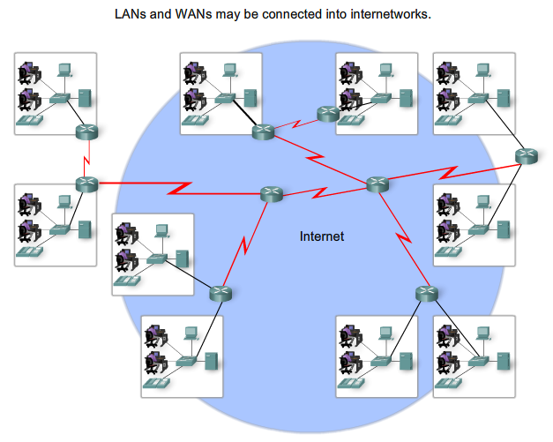
The Internet
The Internet is a worldwide collection of interconnected networks (internetworks or internet for short), cooperating with each other to exchange information using common standards.
Through telephone wires, fiber optic cables, wireless transmissions, and satellite links, Internet users can exchange information in a variety of forms.
Notes:
Section 1.2.3 & 1.2.3.1

Slide 21
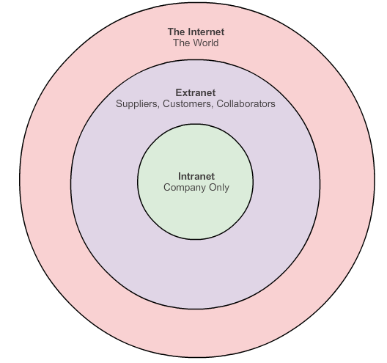
Intranet and Extranet
Notes:
Section 1.2.3.2

Slide 22
Intranet
Intranet is a term often used to refer to a private connection of LANs and WANs that belongs to an organization, and is designed to be accessible only by the organization's members, employees, or others with authorization.
Intranets are basically an internet which is usually only accessible from within the organization.
Intranet – only accessible by employees
From within the company
From home or outside the company

Slide 23
Extranet
An organization may use an extranet to provide secure and safe access to individuals who work for a different organizations, but require company data. Examples of extranets include:
A company providing access to outside suppliers/contractors.
A hospital providing a booking system to doctors so they can make appointments for their patients.
A local office of education providing budget and personnel information to the schools in its district.
Extranet – allow third party to access

Slide 24
1.3 The Network as a Platform
Notes:
Cisco Networking Academy program
Introduction to Networks
Chapter 1: Exploring the Network

Slide 25
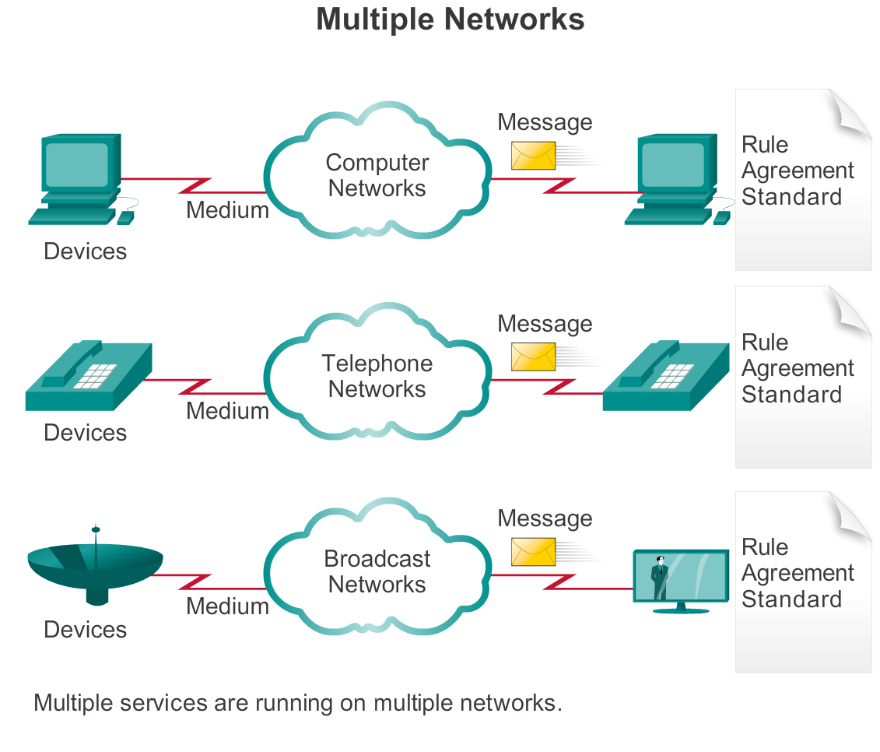
The Converging Network
Notes:
1.3.1.1 The Converging Network

Slide 26
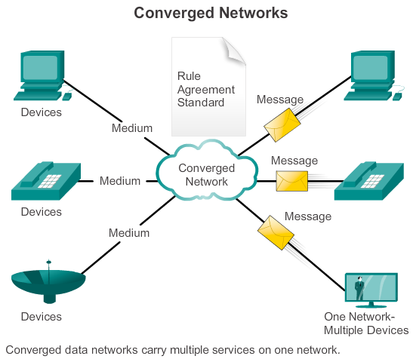
The Converging Network

Slide 27
1.4 Trends of Computer Networking
Notes:
Cisco Networking Academy program
Introduction to Networks
Chapter 1: Exploring the Network

Slide 28
New trends
Some of the top trends include:
Bring Your Own Device (BYOD)
Online collaboration
Video
Cloud computing
Notes:
1.4.1.1 New Trends

Slide 29

Bring Your Own Device (BYOD)
Employee provide the devices to connect to the network.
Ie. Own laptop, tablet
The concept of any device, to any content, in anyway is a major global trend that requires significant changes to the way devices are used. This trend is known as Bring Your Own Device (BYOD).
Notes:
1.4.1.2 BYOD

Slide 30
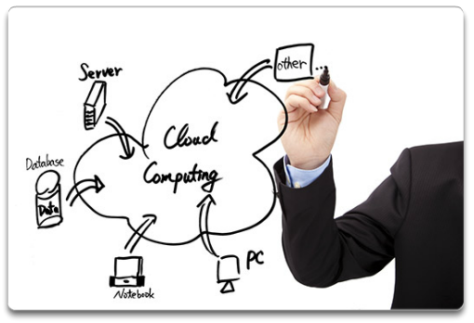
Cloud Computing
Definition – Storage of data in the internet,
Services or applications that are housed in the internet
Cloud computing offers the following potential benefits:
Organizational flexibility
Agility and rapid deployment
Reduced cost of infrastructure
Refocus of IT resources
Creation of new business models
Notes:
1.4.1.5 Cloud Computing

Slide 31
Term | Explanation
A router | is used to determine the path that the messages should take through the network.
A firewall | is used to filter incoming and outgoing traffic.
Dialup telephone | is much slower than either DSL or cable, but is the least expensive option for home users because it can use any telephone line and a simple modem.
satellite | Satellite requires a clear line of sight and is affected by trees and other obstructions.
cable | Cable uses the same coaxial cable that carries television signals into the home to provide Internet access.
A DSL modem | is used to provide Internet connection for a home or an organization. DSL uses a high-speed modem to split the existing telephone line into voice, download, and upload signal channels.
An extranet | is a network area where people or corporate partners external to the company access data.
An intranet | simply describes the network area that is normally accessed only by internal personnel.

Slide 32
Term | Explanation
cable | Cable uses the same coaxial cable that carries television signals into the home to provide Internet access.
A DSL modem | is used to provide Internet connection for a home or an organization. DSL uses a high-speed modem to split the existing telephone line into voice, download, and upload signal channels.
Dialup | much slower than either DSL or cable, but is the least expensive option for home users because it can use any telephone line and a simple modem.
The wired LAN | is affected by BYODs (bring your own devices) when the devices attach to the wired network.
A college wireless LAN | is most likely used by the tablet and smartphone. A wireless WAN would more likely be used by college students to access their cell provider network.
Dedicated leased lines | such as T1/E1 and T3/E3.

Slide 33
Term | Explanation
Cloud computing | allows users to access applications, back up and store files, and perform tasks without needing additional software or servers. Cloud users access resources through subscription-based or pay-per-use services, in real time, using nothing more than a web browser.
TelePresence | is a technology that provides real-time audio and video conferencing. Although IM is a tool that facilitates real-time communication, it is usually limited to personal or one-to-one conversations. Wikis and weblogs are asynchronous tools.
Data confidentiality | ensures that only authorized senders and receivers communicate when data is transmitted.
QoS | means that the network can deliver services in a predictable, measurable, and, if necessary, guaranteed manner. QoS uses classification and queuing to manage the delivery of data, minimizing delay and packet loss.

Slide 34
Term | Explanation
Cellular connectivity | requires the use of the cell phone network.
Satellite connectivity | is often used where physical cabling is not available outside the home or business.
Dedicated networks | are disparate and their services will not communicate with each other.
Converged networks | are capable of delivering voice, video, and data on one communication channel at the same time.
Circuit-switched | networks have a finite capacity to create new circuits. It is possible to occasionally get a message that all circuits are busy and a call cannot be placed. If a circuit fails, a new circuit has to be created to forward the message to its destination. All parts of a single message are transmitted using only one circuit.

Slide 35

Do the final online module 1. Upon completion, ensure you know the following:
Check the final grade/marks.
Check the correct answer upon completion.
Drag and drop features (red = incorrect answer)
That’s how you take each module exam. Good LUCK!!

Slide 36

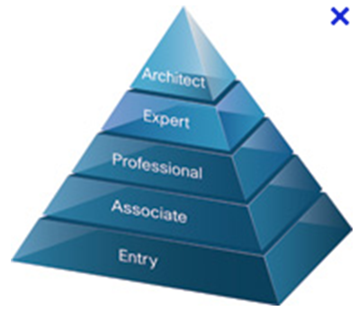
Cisco Certified Network Associate (CCNA)
Notes:
1.4.4.2 CCNA

Slide 37
For more comprehensive teaching materials, practical hands on (packet tracer files), exercises, packet tracer installer, please log in to www.netacad.com Refer to Form B for the mapping , video files and complete ONE tutorial for each week.

